Slide 1
2018 Mid-Biennium Adjustment
Council Workshop – November 14, 2017

Slide 2
Agenda
2018 Budget Decisions
Property Tax – Banked Capacity
Quiet Zone Funding
Other Decisions
Square Footage Tax Increase
External Utility Tax Increase

Slide 3
General Fund 6-Year Forecast
Council Workshop 11/14/2017
Revenue Assumptions:
Loss of SST Mitigation beginning in October 2019
Expiration of Panther Lake Annexation Sales Tax Credit beginning July 2020
Sales Tax Revenues over $2.5m shifted from Capital Resources Fund beginning in 2019
Continuance of 2% internal utility tax in 2021 ≈ $1.5m reallocated to general operations
Use of banked property tax capacity
$2.25m in 2018, $1.5m in 2019, $2.6m in 2020
Additional $500k in revenues for marijuana and card rooms beginning in 2019
Expenditure Assumptions:
An allowance for 3 new Police positions and 1 other GF position each year beginning in 2019
Average cost per position $115k, total cost of $460k annually

Slide 4
General Fund 6-Year Forecast
Council Workshop 11/14/2017

Slide 5
1% Growth Over Time
Council Workshop 11/14/2017

Slide 6
Impact to Kent Residents
Council Workshop 11/14/2017

Slide 7
Quiet Zone Funding
Council Workshop 11/14/2017

Slide 8
Impact to Capital Resources Fund
Council Workshop 11/14/2017

Slide 9
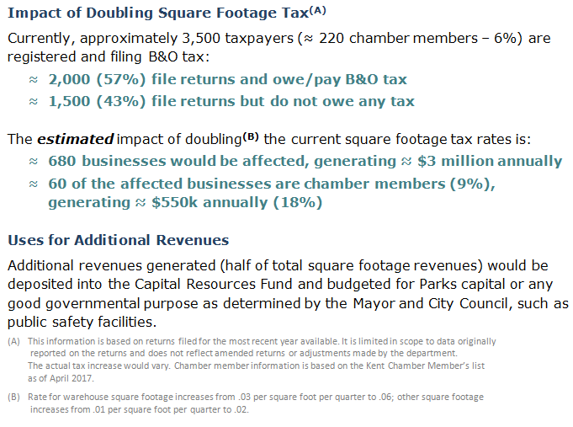
Square Footage Tax Analysis
Council Workshop 11/14/2017

Slide 10
Square Footage Tax What-If Scenario
Council Workshop 11/14/2017
Increases threshold to $1,000,000
Doubles the Manufacturing/Retailing rate
Maximizes the Wholesaling/Services rate

Slide 11
External Utility Taxes
Council Workshop 11/14/2017

Slide 12
2018 Budget Decisions
Council Workshop 11/14/2017
Question 1 - Closing the $2.25m gap
Banked property tax use (at what level)
Other possible methods
Question 2 - Quiet Zone Funding

Slide 13
Upcoming Dates of Note
Council Workshop 11/14/2017
Council Workshop November 21st
Final Decisions
Operations Committee December 5th
Budget Review and Recommendation
Council Meeting December 12th
Adoption of the 2018 Property Tax Levy
Adoption of the 2018 Budget Adjustment

