Slide 1
Fiscal Cliff & Financial Sustainability
Staff Presentation - October 10, 2017

Slide 2
Special Recognition to:
Kathleen Etheredge, Senior Financial Analyst
Michelle Ferguson, Senior Financial Analyst
Shane Sorenson, Senior Financial Analyst
Barbara Lopez, Deputy Finance Director

Slide 3
Agenda
Preface
Fiscal Cliff & Structural Imbalance
Forecasts – Without Additional Revenues
Not Just a General Fund Issue
Potential Mitigations
Forecast – With Additional Revenues
Other Considerations

Slide 4
Preface
Began talking about the fiscal cliff in 2015
More than just a revenue issue
Tough issue to talk about
Information provided is jaw-dropping
Need to incorporate fiscal cliff / structural imbalance as part of decision making

Slide 5
Fiscal Cliff
Known on-going reduction/elimination of current revenue sources:
SST Mitigation Eliminated from State Budget
≈ $2.5m (2019) ≈ $5.0m (2020)
Annexation Sales Tax Credit ends June 2020 ≈ $2.3m (2020) ≈ $4.7m (2021)

Slide 6
Structural Imbalance
Key Factors:
On-going loss of ≈$7.7m annually due to change from origin to destination based sales tax (2008)
On-going costs continue to increase at a much faster pace than ongoing revenues
No specific mechanisms in place to compensate for lost revenues and increased costs (out of alignment with strategic goal for Sustainable Funding)
Proposed adjustments to the General Fund 2018 adopted budget ≈ $2.3m

Slide 7
General Fund 2018 Budget Adjustments
2018 Adopted (Gap) / Surplus | 4,040
Estimated Baseline Adjustments | (2,369,640)
Adjusted Baseline (Gap) / Surplus | (2,365,600)
Additional Adjustments
Approved 2018 Department Budget Requests | (264,630)
Revenue Adjustments | 388,780
Adjusted (Gap) / Surplus | (2,241,450)

Slide 8
Strategic Goal: Sustainable Funding (amounts in millions)
Year | Revenue | Expense | Gap Amt |  | How Filled | Fill Amt
2011 | 74.3 | 75.0 | (0.7) |  | Use of fund balance | 0.7
2012 | 71.3 | 73.4 | (2.1) |  | Business license & permitting fees restructure | 0.5
 |  |  |  |  | Position reductions, incl. layoffs | 1.6
 |  |  |  |  |  | 2.1
2013 | 72.5 | 73.5 | (1.0) |  | Permitting fees to ~75% cost recovery | 1.1
 | Increase Reserves |  | (1.8) |  | Position and program reductions | 1.2
 |  |  | (2.8) |  | 1% internal utility tax - fund balance | 0.6
 |  |  |  |  |  | 2.9
2014 | 76.1 | 75.4 | 0.8
2015 | 77.9 | 81.0 | (3.2) |  | Sales Tax - 4% increase | 1.0
 |  |  |  |  | ECD Permits - fee increase | 0.1
 |  |  |  |  | Property Tax - banked capacity | 1.0
 |  |  |  |  | 1% internal utility tax - reallocate to GF | 0.6
 |  |  |  |  | Use of fund balance | 0.5
 |  |  |  |  |  | 3.2
2016 | 86.7 | 87.6 | (0.9) |  | Sales Tax - increase | 0.4
 |  |  |  |  | Sales Tax - from CRF (one-time) | 0.4
 |  |  |  |  |  | 0.9
2017 | 90.4 | 94.4 | (4.0) |  | Sales Tax - from CRF (ongoing) | 0.5
 |  |  |  |  | Utility Tax - water/sewer rate increases | 0.6
 |  |  |  |  | Permitting fees to 100% cost recovery | 0.9
 |  |  |  |  | Use of fund balance – Parks Capital | 2.0
 |  |  |  |  |  | 4.0
Average Annual Gap ≈ $1.8million

Slide 9
Known & Potential Impacts
Effective Dates
 |  |  | 1/1/2018 |  |  |  |  | 7/1/2019 |  | 7/1/2020
$12.0 million
$7.3 million
$2.3 million
 |  |  |  |  |  |  |  |  |  | $4.7m Annex Sales Tax Credit
 |  |  |  |  |  |  | $5m SST Mitigation
 |  |  | $2.3m Proposed 2018 GF Adjustments

Slide 10
General Fund 6-Year Forecast (amounts in thousands)
Includes:
2018 Proposed Budget Adjustments
Loss of SST mitigation beginning in 2019
Loss of annexation sales tax credit beginning in 2020

Slide 11
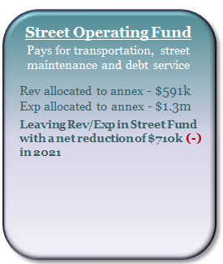
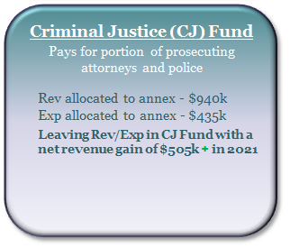
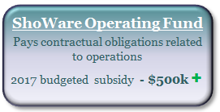
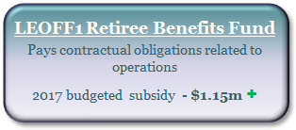
Not Just a General Fund Issue
General Fund
Keeps 72.5% of Sales Tax Revenues; Goes up to 77.7% in 2018. $1.5m +
Eliminated from the State Budget:
SST Mitigation (2019) - $5m (-)
An additional subsidy from GF is needed to fill this gap - $710k +
Annexation Reporting Ends June 2020
Annexation Sales Tax Credit - $4.5m (-)
Increased Street Fund Subsidy - $710k (-)
2017 budgeted subsidy - $2.5m +
Shift of eligible costs to CJ Fund - $505k +
Net loss to General Fund - $4.7m (-)
Move eligible costs from GF to offset revenue gain - $505k (-)
2017 Budgeted Subsidies (ongoing):
Street Operating Fund - $2.5m (-)
LEOFF1 Retiree Benefits - $1.15m (-)
ShoWare Operating - $500k (-)
+ Positive Impact to Fund
(-) Negative Impact to Fund

Slide 12
Potential Mitigations
Policy Options for Current Revenues
Shift sales tax from capital as debt service is paid
CRF allocation to IT/Street capital (4% internal utility tax)
Continue 2% internal utility tax - $1.5m (debt paid 2020)
B&O tax allocation
New Revenue Options (tax/fee increases)
Banked Property Tax Capacity - $3.9m
Transportation Benefit District (car tabs and/or sales tax)
B&O tax rates
Voter approved taxes
Reduce expenses
Strategic use of fund balance (one-time; maintain reserves per policy)

Slide 13
General Fund 6-Year Forecast w/ 2018 Proposed Adjustments, Annexation Impacts, SST Mitigation Loss, 4 new FTEs each year and new revenue sources
Staff Presentation 10/10/2017
Includes:
Loss of SST Mitigation beginning in July 2019
An allowance for 3 new Police positions and 1 other GF position each year beginning in 2019
Average cost per position $115k, total cost of $460k annually
Sales Tax Revenues over $2.5m shifted from Capital Resources Fund beginning in 2019
Reduced Street Fund Subsidy from General Fund to $1.0m per year beginning in 2019
Continuance of 2% internal utility tax in 2021 ≈ $1.5m reallocated to general operations
Use of banked property tax capacity
$2.25m in 2018, $1.7m in 2020, $1.9m in 2021
Additional $500k in revenues for marijuana and card rooms beginning in 2019

Slide 14
Other Considerations
Outstanding Budget Challenges:
Sustainable and balanced budget / level of service
Parks capital
Police & Public Safety staffing
City campus space planning
Must Do:
Resolve ≈ $2.3m General Fund gap for 2018
Should Do:
Address annual, ongoing structural imbalance
Begin to address $4.7m annexation sales tax credit and $5m SST mitigation loss impacts in the next Biennium

Slide 15
Questions?

