Slide 1
COUNCIL WORKSHOP October 4, 2022
OVERVIEW OF
OTHER FUNDS

Slide 2
AGENDA
SPECIAL COUNCIL WORKSHOP 10-04-2022
Special Revenue Funds
Enterprise Funds
Internal Service Funds
Timeline

Slide 3
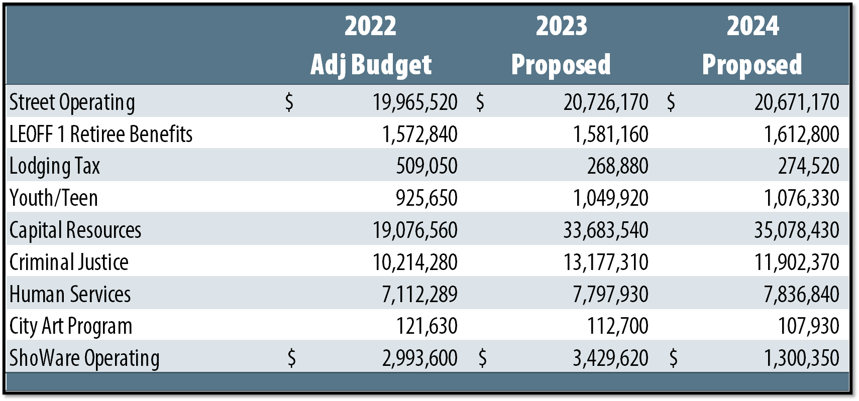
Special revenue funds
SPECIAL COUNCIL WORKSHOP 10-04-2022
Notes:
Page 36

Slide 4
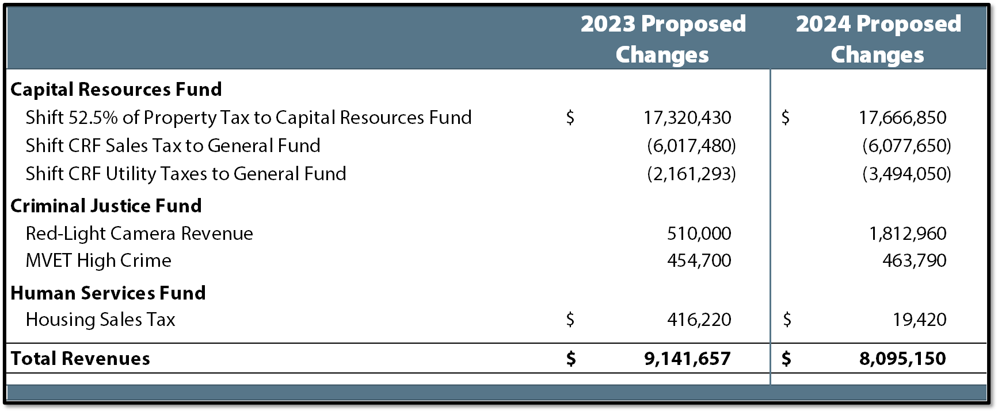
Special revenue funds – major revenue changes
SPECIAL COUNCIL WORKSHOP 10-04-2022
Notes:
Page 38

Slide 5
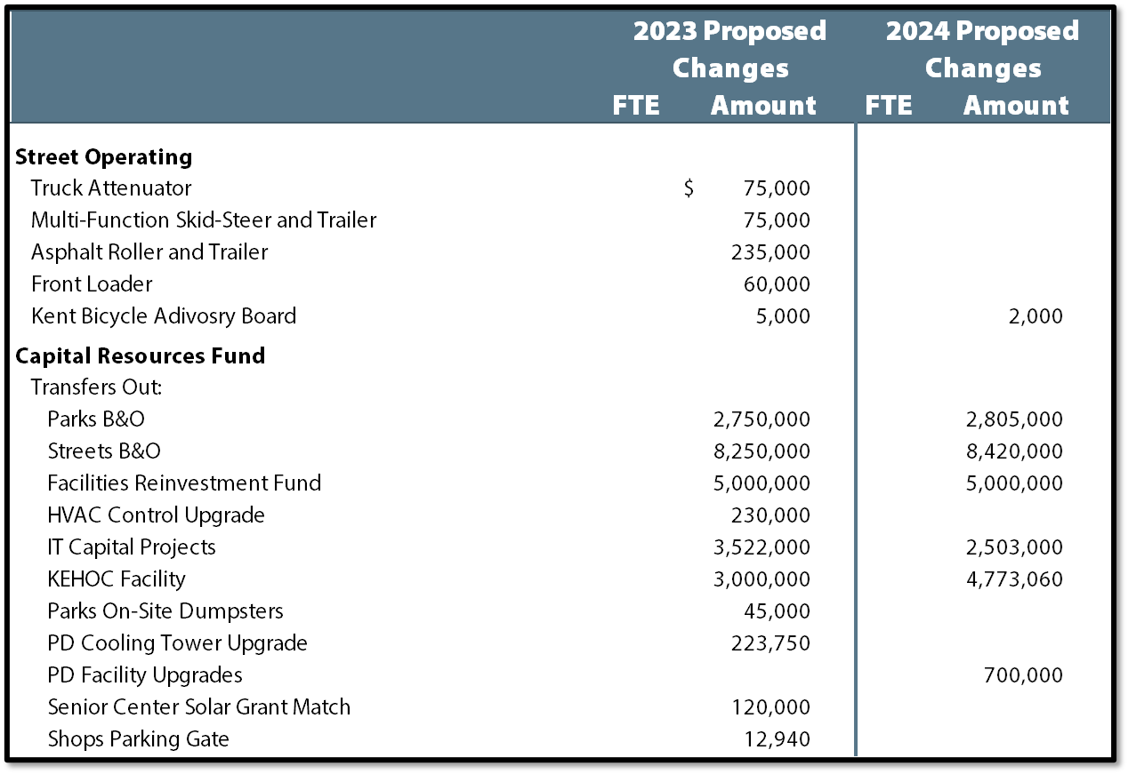
Special revenue funds – major Expenditure changes
SPECIAL COUNCIL WORKSHOP 10-04-2022
Notes:
Page 39

Slide 6
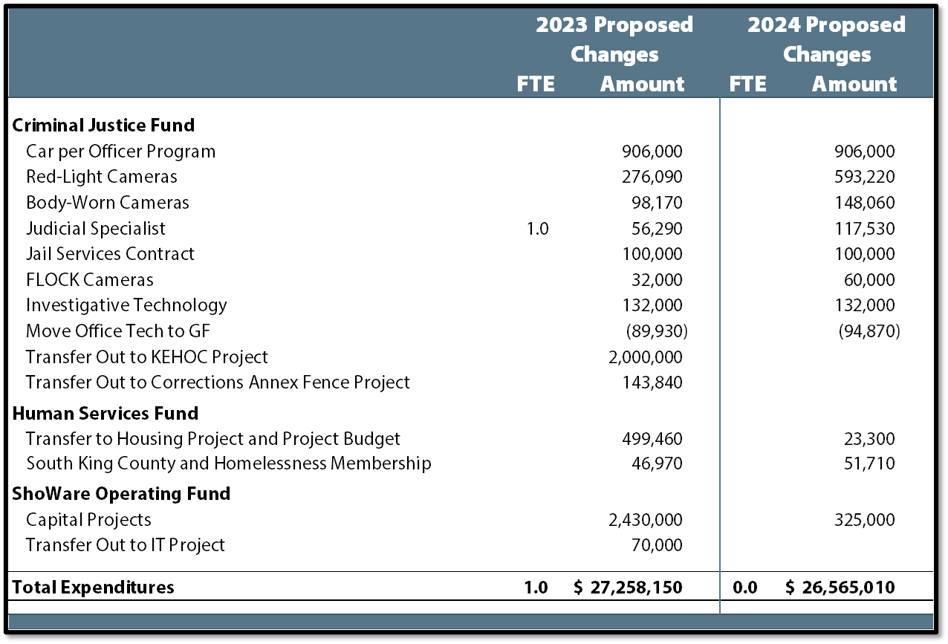
Special revenue funds – major Expenditure changes
SPECIAL COUNCIL WORKSHOP 10-04-2022
Notes:
Page 39

Slide 7
Red-light camera fund (Question #6)
SPECIAL COUNCIL WORKSHOP 10-04-2022
 | 2023 | 2024
Estimated Beginning Fund Balance | $ 1,785,870 | $ 1,632,120
Baseline Revenues | 2,587,540 | 2,600,480
New Revenues | 510,000 | 1,812,960
Total Revenues | 3,097,540 | 4,413,440
Baseline Expenditures | 2,820,740 | 3,143,550
Additions: Judicial Specialist | 56,290 | 117,530
Red-Light Cameras | 276,090 | 593,220
Body-Worn Cameras | 98,170 | 148,060
Total Expenditures | 3,251,290 | 3,321,490
Estimated Ending Fund Balance | $ 1,632,120 | $ 2,724,070

Slide 8
Affordable housing sales tax (Question #3)
SPECIAL COUNCIL WORKSHOP 10-04-2022
Affordable Housing Sales Tax
City began collecting in late 2020 – expires after 20 years – limited to nearly $200K per year
With House Bill 1406, the sales tax rate did not increase. It allowed the City to receive a portion of the State’s sales tax for affordable or supportive housing.
Revenues must be used for affordable and supportive housing.
Housing Sales Tax
City began collecting in 2021
House Bill 1590 provided the City with the authority to increase our sales tax rate by 0.1% for housing and homelessness needs including mental and behavioral health services.
60% of the revenues must be used for construction or acquiring affordable housing, constructing or acquiring behavioral health-related facilities, etc. The City is part of SKHHP.
40% of funds must be used for behavioral health programs/services or housing-related services.

Slide 9
Affordable housing sales tax (Question #3)
SPECIAL COUNCIL WORKSHOP 10-04-2022

Slide 10
Enterprise funds
SPECIAL COUNCIL WORKSHOP 10-04-2022
Notes:
Page 40

Slide 11
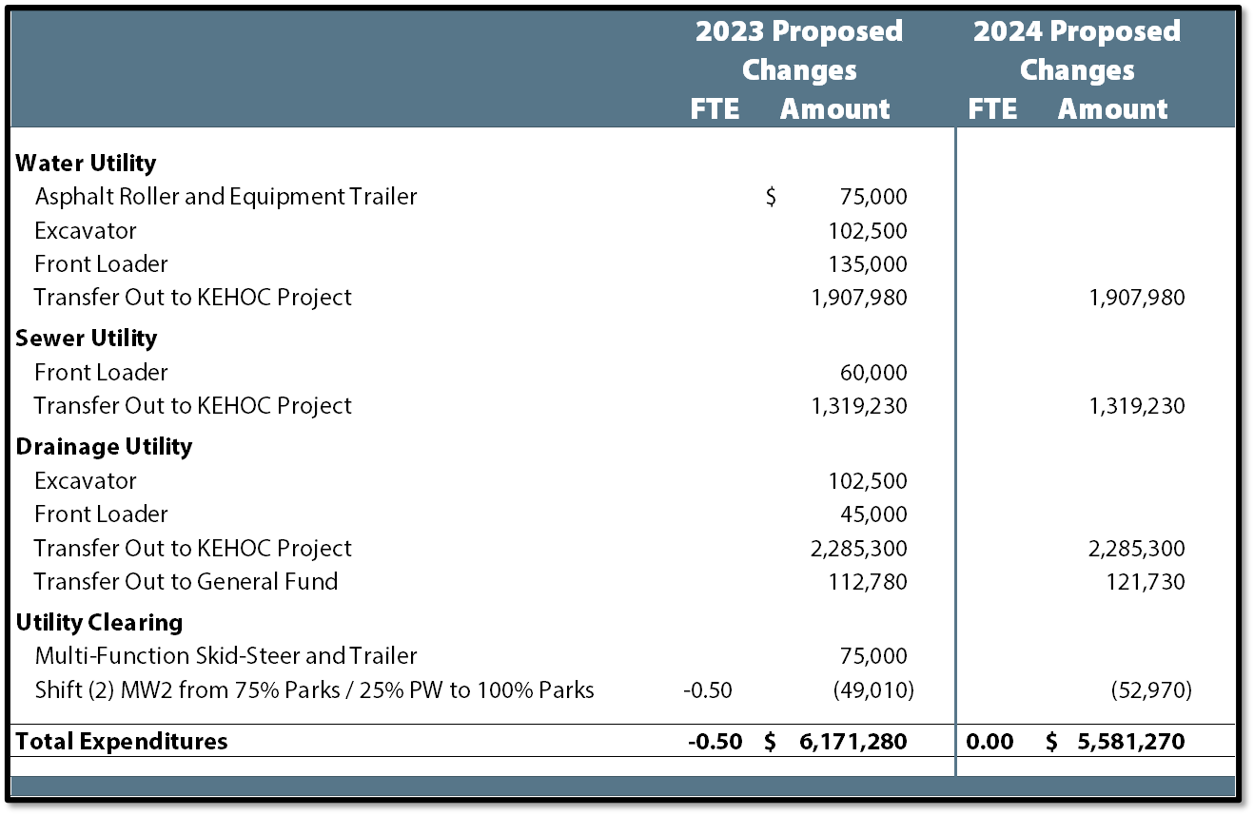
Enterprise funds – major expenditure changes
SPECIAL COUNCIL WORKSHOP 10-04-2022
Notes:
Page 41

Slide 12
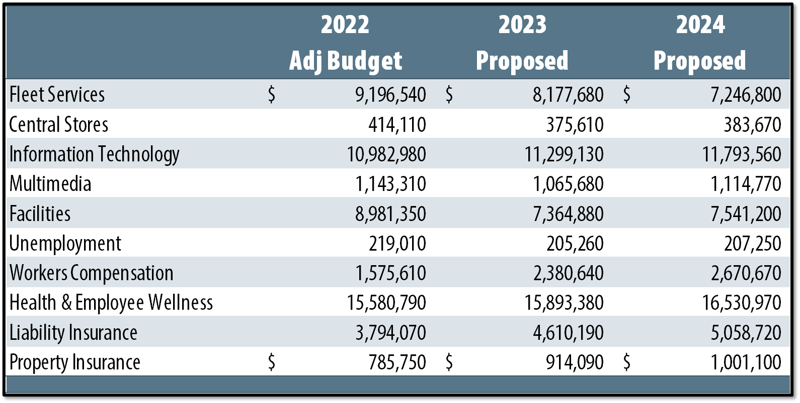
Internal service funds
SPECIAL COUNCIL WORKSHOP 10-04-2022
Notes:
Page 42

Slide 13
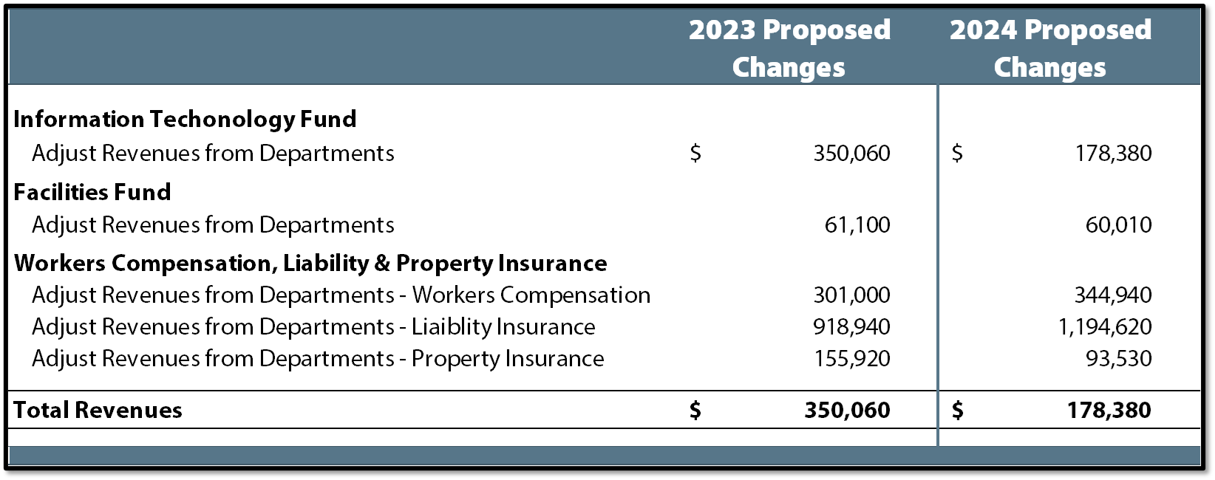
Internal service funds – major revenue changes
SPECIAL COUNCIL WORKSHOP 10-04-2022
Notes:
Page 43

Slide 14
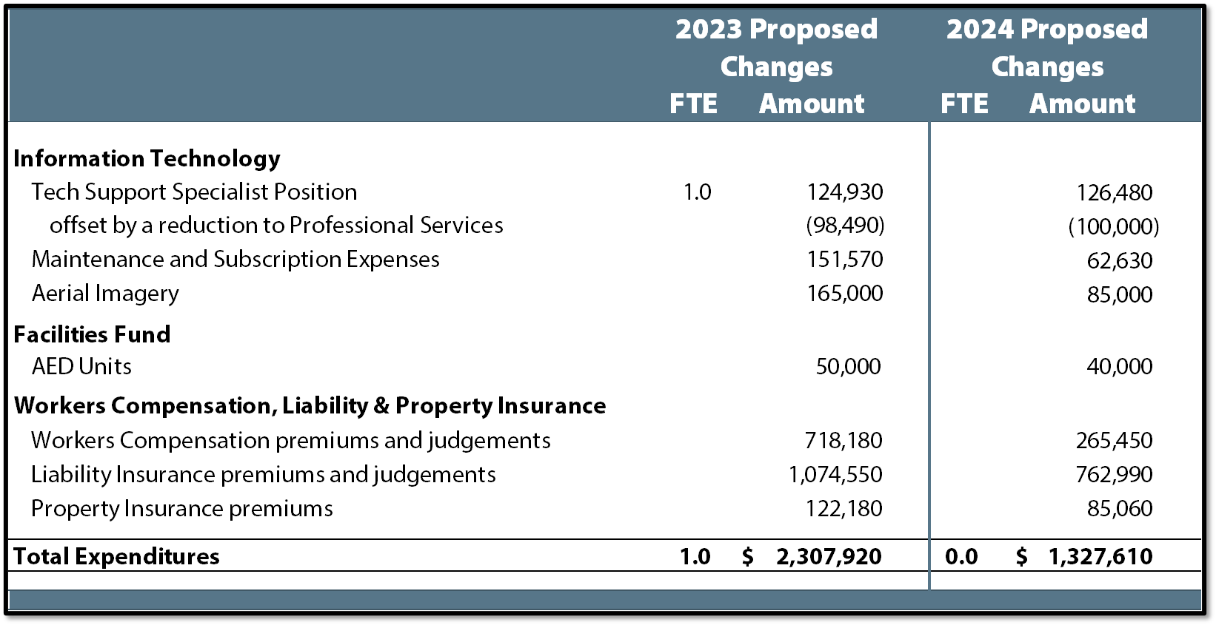
Internal service funds – major expenditure changes
SPECIAL COUNCIL WORKSHOP 10-04-2022
Notes:
Page 43

Slide 15
TIMELINE
SPECIAL COUNCIL WORKSHOP 10-04-2022

Slide 16
Questions?
SPECIAL COUNCIL WORKSHOP 10-04-2022

